Slide 1
A Toolkit for Music Processing and Analysis
Bruno Azevedo
Informatics Engineering Msc
University of Minho
Professor José João Dias de Almeida
February 2013

Slide 2
Context and Motivation
Textual Musical Notation
  Abc
  LilyPond
  MusicXML
Unix Philosophy
  “This is the Unix philosophy: Write programs that do one thing and do it well. Write programs to work together. ...”
              Doug McIlroy

Slide 3
Case Study
Wiki::Score
  Wiki
  Edition of music scores
  Abc Notation

Slide 4
Solution
Toolkit
  Small problems
  Articulate results

Slide 5
Design Goals
Toolkit
  Automatic Validation
  Error Detection
  Error Fixing
  Statistical and Musical Analysis
  Open-Source
  Unix Philosophy

Slide 6
Design Goals
Musical Corpora
  Corpus of scores
  Tools for statistical calculation

Slide 7
Design Goals
Musical Information Representation
  Order of symbols
  Indispensable information
  Scripting

Slide 8
Design Goals
Musical Information Visualization
  Appropriate format
  Intelligible output
  Reveal some feature

Slide 9
Musical Notations
Abc
  Notation standard
  Plain text
  Compact and clean syntax
  Human readable
  Open source
  Original Goal: Share folk tunes via textual format

Slide 10
Musical Notations
LilyPond
  Software Package
  Plain text
  Friendly syntax
  Open source
  Original Goal: Print scores similar to hand engraved scores of the past

Slide 11
Musical Notations
MusicXML
  XML-based format
  Plain text
  Complex syntax
  Proprietary, but freely usable under Public Licence
  Original Goal: Share scores between applications and archive scores for use in the future

Slide 12
Projects and Tools
abcm2ps
  Translates Abc to sheet music scores
  PostScript or SVG format
  De facto standard typesetter
  Actively maintained

Slide 13
Projects and Tools
abc2midi
  Converts Abc to MIDI
  De facto standard MIDI generator
  Part of abcMIDI package

Slide 14
Projects and Tools
EasyAbc
abcpp Preprocessor
Abcp
Music::Abc::Archive
Music21
...

Slide 15
Musical Corpora
What for?
  Calculate patterns
  Assess what is expected
  Calculate similarities
  Generate statistics
  Testing material
  Data sets to train systems that learn from data

Slide 16
Musical Corpora
What can be analyzed?
  Find sets of vertical patterns
  Find significant statistical differences between melodies
  Identify trends and changes throughout a historical time period
  ...

Slide 17
Internal Representation of Musical
Information
Structure
  Depends on its final purpose
  Mainly two types
    Sequential
    Hierarchic
  Horizontal and vertical dimensions
    Sparse matrix

Slide 18
Internal Representation of Musical
Information
Early conclusion
  Sequential and Hierarchic structures are more suited to horizontal readings
  Structures like sparse matrices allow both horizontal and vertical readings
  The latter does not maintain original order of symbols
  The completeness of a structure is determined by its ability to support all tasks required by its purpose

Slide 19
abcm2ps's approach
Internal Representation
  Sequential structure
  Ordered list of symbols
  Contains all data from an Abc score
  Appropriate to apply scripting
  Basis for a more complex structure

Slide 20
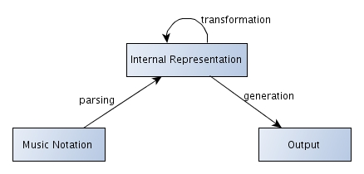
Abc Scripting
Proof of Concept
  Three stage process
    Data Extraction/Parsing
    Transformation of the generated representation
    Output Generation

Slide 21
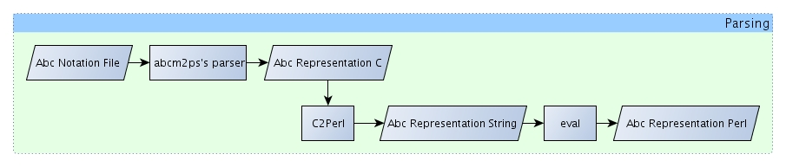
Data Extraction
Parser
  Abcm2ps's parser
Internal representation adaptation
  C2Perl program

Slide 22
    Transformation of the generated representation
Generic Processor
  Higher-Order Processing
  Systematic
  Set of processing strategies
  Inspired in XML::DT

Slide 23
    Output Generation
Output in specific format
Output may have same type as input

Slide 24
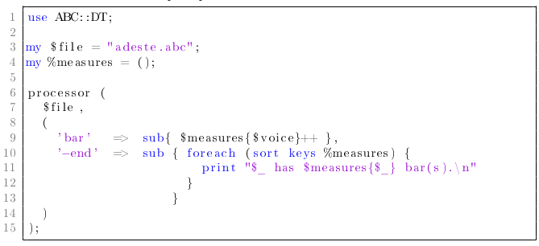

    Example

Slide 25
    Conclusions
Planning the corpus construction is essential for the overall quality of the toolkit
The internal representation must be complete enough to allow the application of analytic tasks
The sequential structure is appropriate for scripting and more
The proof of concept proves that it is possible to reduce the complexity of an elaborate problem by tackling its parts through scripting

Slide 26
    Research Planning
Resume the development of the processor
Verify parser's robustness
Create a set of tests for the toolkit
Create Unix-like tools for music
Build Abc Corpus
Develop statistical and musical analysis tools
Write the dissertation

Slide 27
A Toolkit for Music Processing and Analysis
Bruno Azevedo
Informatics Engineering Msc
University of Minho
Professor José João Dias de Almeida
February 2013

